Slide 1

Characterizing and Predicting Early Reviewers for Effective Product Marketing on E-Commerce Websites
Guide:
Dr. E Sudharshan
Haniya Kulsum – 216Y1A0551
K. Anusha – 216Y1A0561
D. Snehitha – 216Y1A0541
Ayesha Fathima – 216Y1A0511

Slide 2
ABSTRACT
Early product reviews on e-commerce platforms significantly influence customer perceptions and sales. This project identifies the behavior of early reviewers and proposes a predictive system to engage them. The system uses user behavior data, product attributes, and predictive algorithms to forecast early reviewers for new products, thereby enhancing marketing strategies and accelerating product traction.

Slide 3
INTRODUCTION
Online reviews play a vital role in shaping consumer decisions.
Early reviews disproportionately affect product perception and success.
Identifying early reviewers enables businesses to harness social proof early.
The aim is to analyze behaviors and build a predictive system.

Slide 4
LITERATURE SURVEY
S.No | Research Work | Techniques/Methods Used | Key Findings | Limitations | Reference
1 | Chen et al. (2015) - Nonpurchase feedback and product sales | Statistical analysis of review impact on sales | Highlighted that even non-purchase reviews significantly affect consumer trust and buying behavior | Limited to specific product categories and platforms | [1]
2 | He et al. (2018) - Early reviewer behavior modeling | Margin-based embedding model, behavioral features | Early reviewers give higher ratings, more helpful reviews, and influence product popularity | Cold-start problem for new products, dependency on labeled data | [4]
3 | Rogers (1962) - Diffusion of Innovations Theory | Adoption curve, adopter segmentation | Conceptual framework used to define early, majority, and laggard reviewers | Lacks real-time predictive capabilities | [8]
4 | Banerjee (1992) - Herd Behavior Theory | Behavioral economics modeling | Explained that early opinions influence others (social proof) in online purchases | May not account for all user motivations or review authenticity | [14]
5 | Kim et al. (2006) - Review helpfulness prediction | Sentiment analysis, NLP, user voting metrics | Helpfulness votes correlate with early reviews and influence review visibility | Requires linguistic data and may be biased by platform algorithms | [20]

Slide 5
EXISTING SYSTEM
Currently, e-commerce platforms often employ a few common strategies, though not always formalized as "systems" for early reviewer prediction:
Broad Promotional Emails/Notifications: When a new product launches, a general email blast or push notification is sent to a large segment of the user base, often based on broad category interests or past purchase history. This is inefficient as many recipients are not likely to be early reviewers.
First-Purchaser Targeting: Some platforms might invite users who purchase a product within the first few days/weeks to leave a review. While this targets actual early purchasers, it doesn't predict who will be an early reviewer before purchase, and many early purchasers might not be prolific reviewers.
First-Purchaser Targeting: Some platforms might invite users who purchase a product within the first few days/weeks to leave a review. While this targets actual early purchasers, it doesn't predict who will be an early reviewer before purchase, and many early purchasers might not be prolific reviewers.

Slide 6
PROPOSED SYSTEM
We propose a system for characterizing and predicting early reviewers for effective product marketing on e-commerce websites. The system aims to proactively identify users who are likely to provide early reviews for new products, enabling targeted engagement strategies.
Proposed System Features:
User Profiling Module: This module will build comprehensive profiles for each user based on their historical interactions on the e-commerce platform. Features will include:
Review History: Number, frequency, and timing of past reviews (especially early reviews on other products).
Review Quality: Helpfulness votes received on past reviews, review length, detail, and sentiment.

Slide 7
Purchase History: Products purchased, purchase frequency, and product categories.
Browse Behaviour: Products viewed, time spent on product pages, search queries.
Demographic Information (if available and permissible): Age, location, etc.
Engagement Level: Participation in forums, Q&amp;A sections, or other community features.

Slide 8
ALGORITHMS
For User Profiling and Product Analysis:
Feature Extraction Techniques: Techniques like TF-IDF (Term Frequency-Inverse Document Frequency) or embedding models (e.g., Word2Vec, Doc2Vec) can be used to represent review text and product descriptions numerically.
Clustering Algorithms (e.g., K-Means, DBSCAN): Can be used to group users with similar behaviors or products with similar attributes for better feature engineering.
Dimensionality Reduction Techniques (e.g., PCA): To reduce the number of features while retaining important information.

Slide 9
TECHNOLOGY
Programming Languages: Python (with libraries like Pandas, NumPy) is a common choice for data manipulation and analysis.
RESTful API Frameworks (e.g., Flask): To expose the prediction models as APIs for integration with the e-commerce platform.

Slide 10
DESIGN
The Early Reviewer Predictor is a full-stack web application built with the following architectural components:
Frontend: HTML templates rendered using Flask (from templates/ directory).
Backend: Python Flask-based RESTful service (app.py) that handles routing, user interaction, and predictions.
Database: SQLite (database.db) used to store user reviews, reviewer profiles, and early reviewer data.
Modules:
reviewer_analytics.py: Performs analytics on review data.
models.py: Defines data models and functions for reviewer behavior.
database.py: Manages database connections and queries.
Workflow:
User uploads or views product reviews.
Backend analyzes the data and applies predictive logic.
Results are displayed through the web interface.

Slide 11
IMPLEMENTATION
The implementation will involve a combination of Python for data processing and machine learning, alongside standard data infrastructure components.
Data Ingestion and Storage:
E-commerce Data: Assume access to a central data warehouse
(e.g., a PostgreSQL database or a data lake with Parquet files)
containing historical orders, reviews, and products tables.
Tools: Use SQL for initial data extraction. Apache Spark or Pandas
in Python for loading and initial cleaning of large datasets.
Data Preprocessing and Feature Engineering (Python):
Language & Libraries: Primarily Python with pandas for data
manipulation, NumPy for numerical operations, and scikit-learn for
preprocessing utilities.

Slide 12
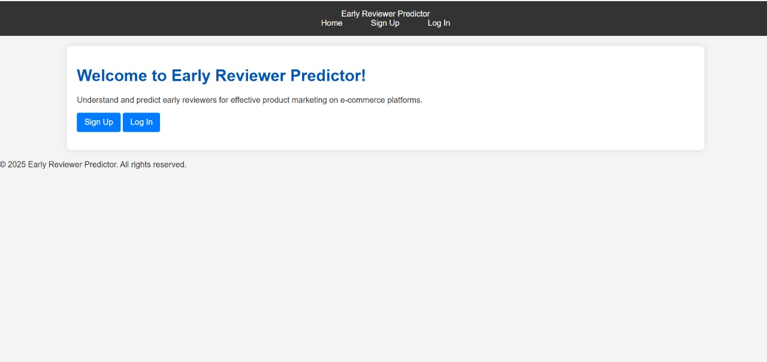
RESULTS

Slide 13
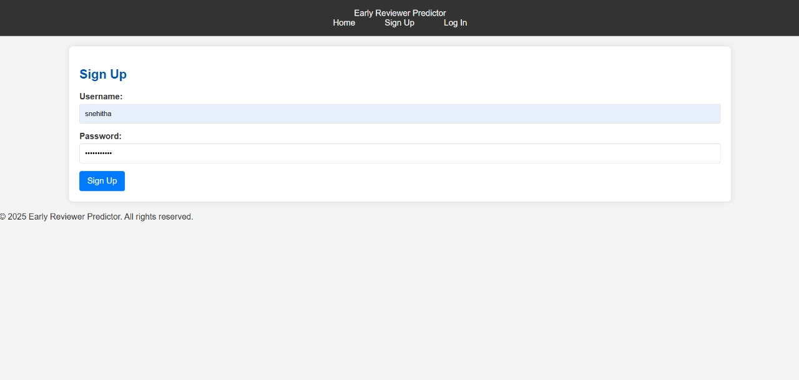

Slide 14
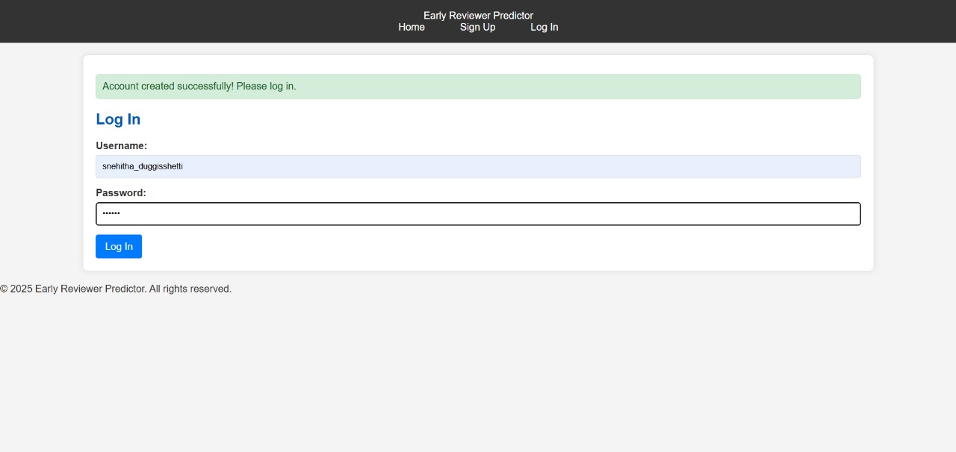

Slide 15
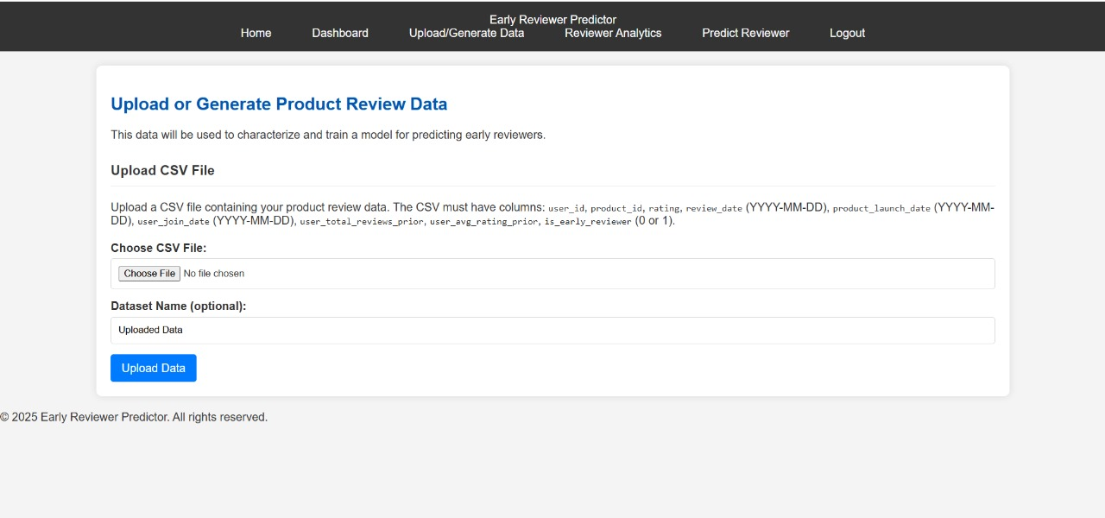

Slide 16
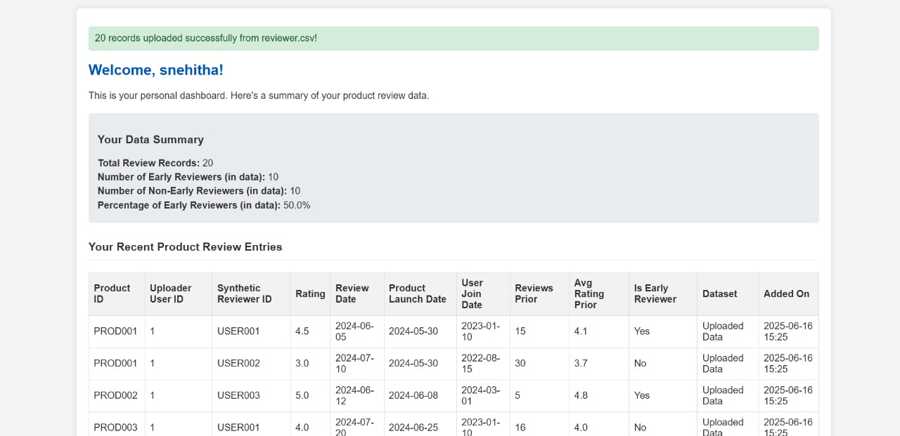

Slide 17
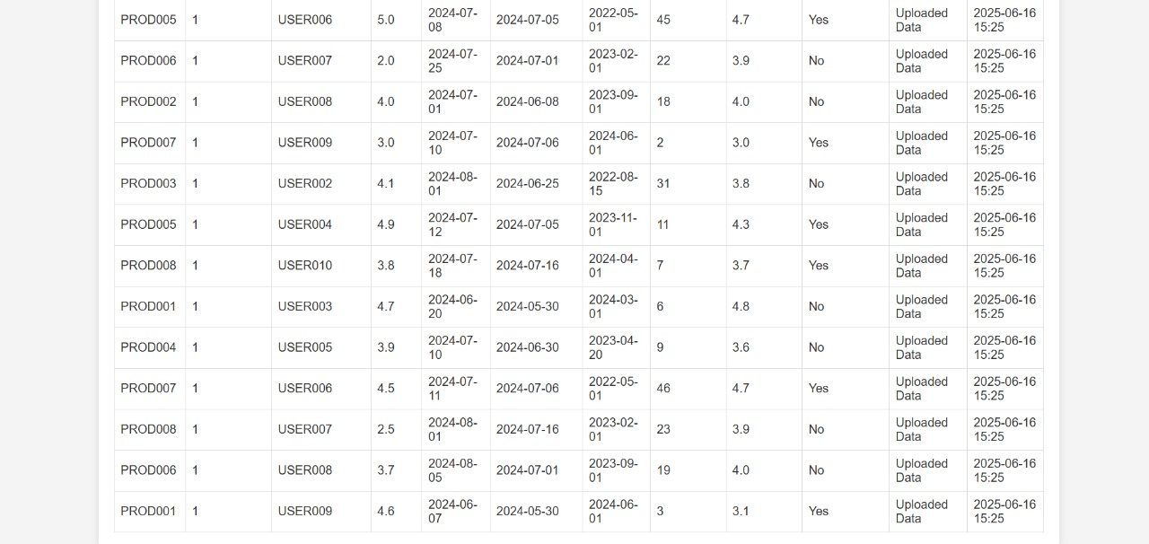

Slide 18
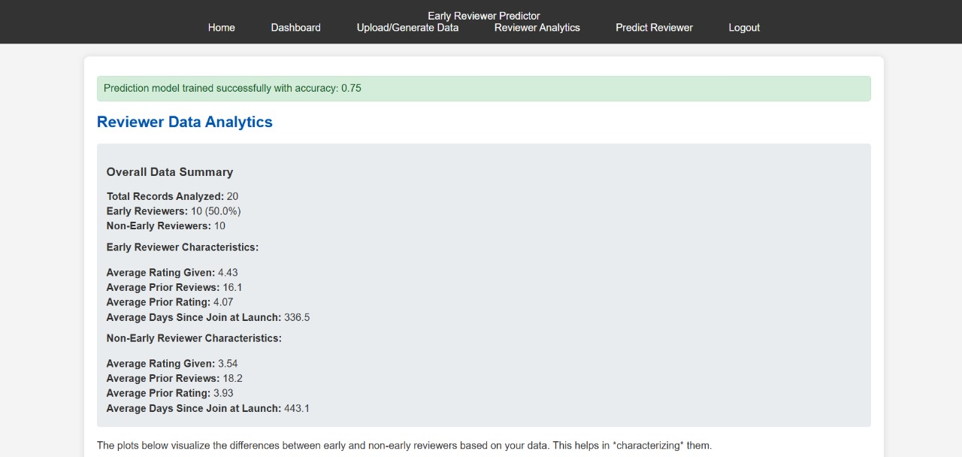

Slide 19
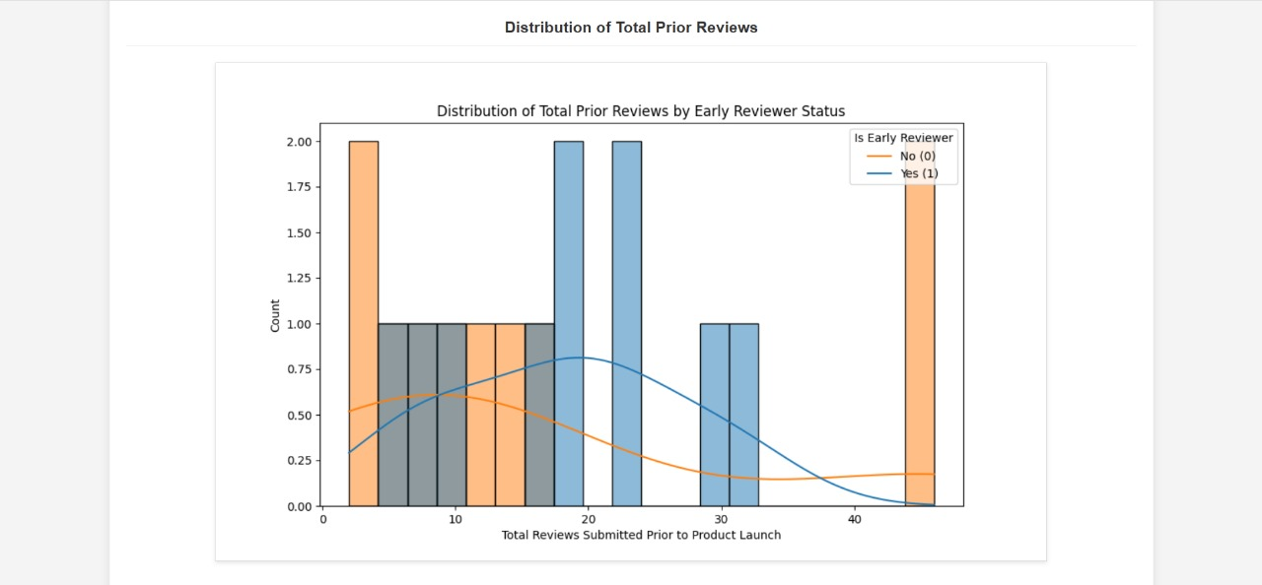

Slide 20
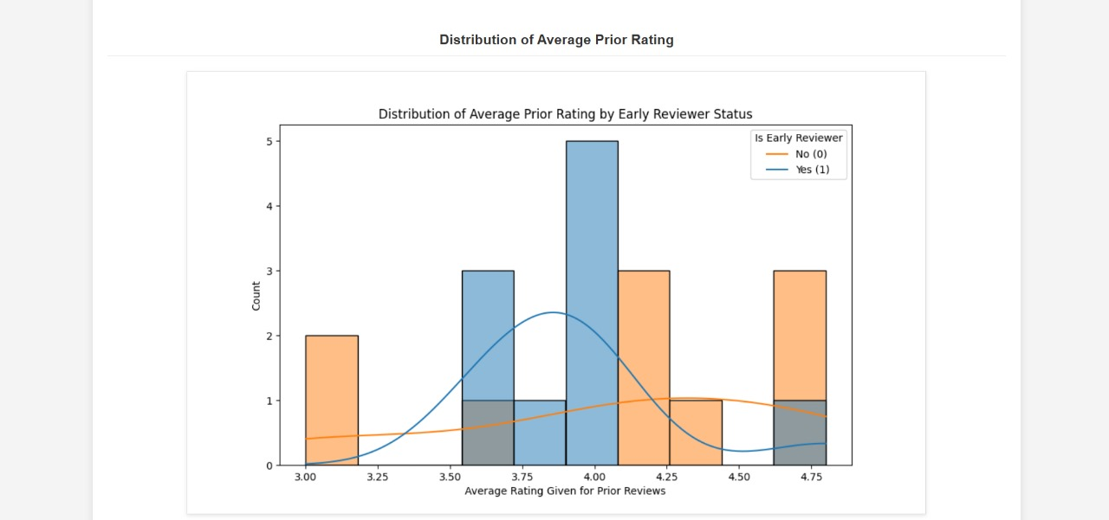

Slide 21
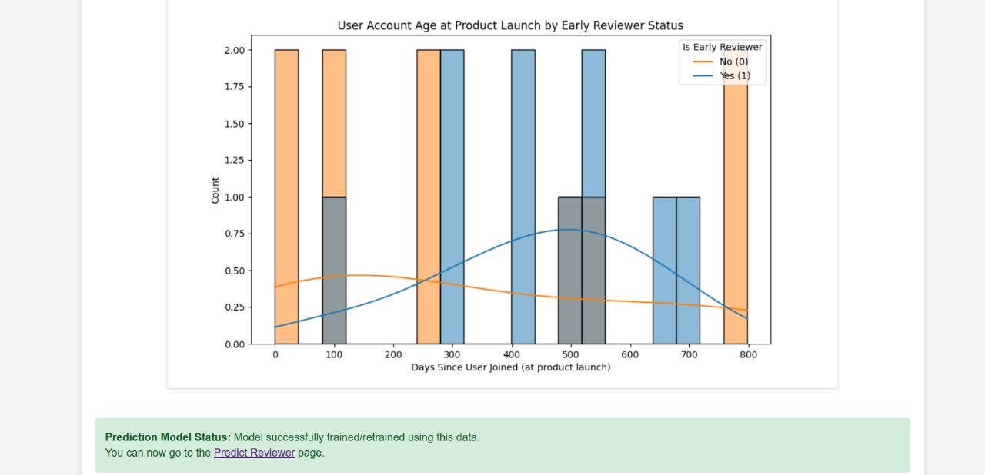

Slide 22
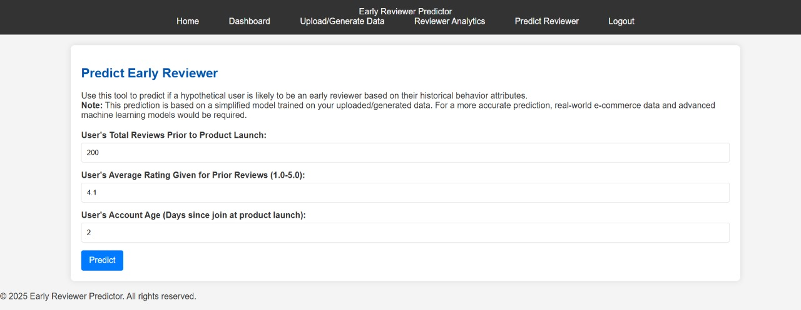

Slide 23
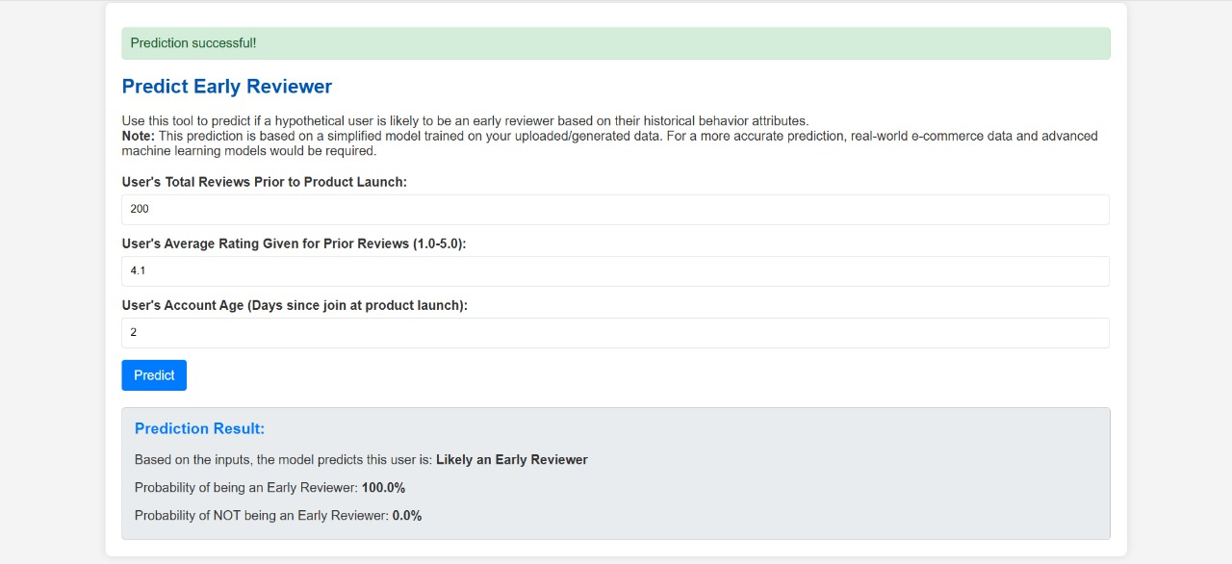

Slide 24
TESTCASES
Test Case | Input | Expected Output | Result
TC01 | User with frequent reviews in tech category | Identified as early reviewer for new tech product | ✅ Pass
TC02 | New user with no prior reviews | Not identified as early reviewer | ✅ Pass
TC03 | Reviewer with short, low-rated past reviews | Not flagged as potential early reviewer | ✅ Pass
TC04 | Active reviewer with high helpfulness votes | Selected as early reviewer | ✅ Pass
TC05 | Upload new CSV with reviews | Reviews analyzed, predictions displayed | ✅ Pass

Slide 25
CONCLUSION
Early reviewers are key to product success on e-commerce platforms.
The proposed system predicts early reviewers using user behavior and product features.
Enables targeted marketing, faster feedback, and better product launch outcomes.
Overcomes cold-start and improves early product engagement.

